Slide 1

“BANK LOAN OF CUSTOMERS PROJECT”
GROUP -03
Name Of Group Members :-
Mrs. Ankita Chaugule
Mrs. Nisha Singh
Ms. Pooja Dolai
Mr. Sama Sanjay Kumar
Mr. Shivraj Sagar
Mr. Shreenidhi M M

Slide 2
OBJECTIVE
The main objective of Bank Loan Customers Project is to predict loan default likelihood, analyse key factors influencing loan repayment, and create informative visualizations to present findings effectively.
By utilizing Excel, Power BI, My SQL, and Tableau, we can streamline data processing, generate insights, and build interactive dashboards for a comprehensive analysis.
These objectives will guide us in leveraging the tools efficiently to achieve a thorough understanding of the loan data.
By achieving these objectives, the Bank Loan Customers Project aims to enhance the bank's competitiveness, profitability, and customer satisfaction while effectively managing credit risk and ensuring regulatory compliance.

Slide 3
INTRODUCTION
Bank Loan of Customers.
Domain – Finance.
Datasets: Finance_1.xlsx & Finance_2.xlsx.
Project work done on Excel , My SQL , Power BI & Tableau.
The project involved in analyzing loans provided by a financial institution to customers of diverse grades and sub-grade levels. The analysis encompassed factors such as loan disbursement reasons, funded amounts, revolving balance values, customer locations in various states and geographic locations, as well as customer payment modes, and the latest payment values..

Slide 4
STRATEGY
Credit Risk Assessment
Financial Statement Analysis
Evaluating the financial health, credit history, and repayment capacity of borrowers to determine the likelihood of default.
Reviewing financial statements, income statements, balance sheets, and cash flow statements to assess the borrower's financial stability and ability to repay the loan..
Collateral Evaluation
Loan Structuring & Portfolio Management
Determining the terms and conditions of the loan, including interest rates, repayment schedules, and any special provisions based on the borrower's risk profile and financial needs.
Monitoring and managing the composition and performance of the loan portfolio to optimize risk-return trade-offs and achieve strategic objectives
Assessing the value and quality of collateral provided by the borrower to secure the loan, which serves as a form of protection for the lender in case of default

Slide 5
Year Wise Loan Amount Status
01
Grade And Sub-grade Wise Revolving Balance
02
Verified Vs Non Verified Status
03
KPI’S
State Wise & Month Wise Loan Status
04
05
Home Ownership Vs Last Payment Date

Slide 6
FRAMEWORK FOR EXCEL
DATA CLEANING
DASHBOARD REFINEMENT
INTEGRATION
CONSOLIDATION
KPI’S

Slide 7
Year wise loan amount StatUs
This is bar chart showing the loan amounts over the years 2007 to 2011. The amounts are represented in millions of dollars. Here's a breakdown of the data:
2007: $2 million
2008: $14 million
2009: $46 million
2010: $122 million
2011: $261 million
The chart illustrates a significant increase in loan amounts from 2007 to 2011, with a sharp rise between 2010 and 2011. This indicates a substantial growth in lending activity over these years.
Conclusion: The visualization shows a consistent increase in loan amounts from 2007 to 2011. This suggests that the bank's lending activity grew steadily over these years. It could indicate a growing economy or increased demand for loans during this period
Fig 1.Bar chart with loan amount from year 2007-2011 with amount in millions.

Slide 8
GRADE & SUB GRADE WISE REVOLVING BALANCE
The lowest orders with a review score of 2 using a credit card are 2,407.
Grade G having sub-grade G4 shows highest avg. revolving balance i.e. 24833 among all grade.
Grade A having sub-grade A2 shows lowest avg. revolving balance i.e. 9287 among all grade.
Higher revolving balances in specific grades/sub-grades might indicate a need for adjusted interest rates or credit limits.
Conclusion: The visualization likely categorizes loans based on their grade and subgrade and shows the revolving balance associated with each category. Higher-grade loans may have higher revolving balances, indicating potentially larger loan amounts or higher credit limits for borrowers with better creditworthiness.
Fig 2.Clustered bar with x-axis and y-axis.

Slide 9
Total Payment FOR VERIFICATION STATUS Vs NON-Verification Status
The borrowers having verified status shows higher payment amount and having non-verified status shows lower payment amount.
It’s helps to identify significant differences in repayment behavior between these two groups
Conclusion:
Initial weakness: The low verification status indicates that banks had inadequate or less stringent verification processes
Progressive improvement:- However, a 59% verification rate suggests that there is still room for improvement.
Compliance and fraud prevention:- Ensure strict adherence to regulatory guidelines, such as KYC
Continuous monitoring and improvement: effectiveness of verification processes
Fig 3.Pie Chart .

Slide 10
State Wise & Month Wise Loan Status
California (CA) has the highest amount of fully paid loans and charged off
Maine : one record of fully paid loans and no charged-off loans in Maine
California have a relatively higher rate of successfully repaying their loans. It reflects a positive trend in loan repayment behavior in the state.
Relatively lower loan activity in Maine state.
Conclusion:-
Further investigate the reasons behind the higher percentage of charged-off loans in California
Analyze the factors contributing to the lower loan activity in Maine
Implement risk management strategies and credit monitoring practices to mitigate the risk of loan defaults and improve overall loan portfolio performance.
Fig 4.Line Chart with x-axis and y-axis.

Slide 11
Home ownership Vs last payment date statUs
In 2012, the last payment amount for mortgage and rent was $10 million over a loan amount of $31 million.
The last payment amount suggests that the borrower made a substantial effort to reduce their outstanding mortgage and rent obligations.
Fig 5.Clustered bar with x-axis and y-axis.
It would be beneficial to review the terms of the mortgage and rent agreement to understand the specific terms and conditions.
Assess the borrower's financial situation to ensure their ability to make future payments and meet their obligations.
Consider consulting with a financial advisor or mortgage professional to evaluate the borrower's options for optimizing their mortgage and rent payments.

Slide 12
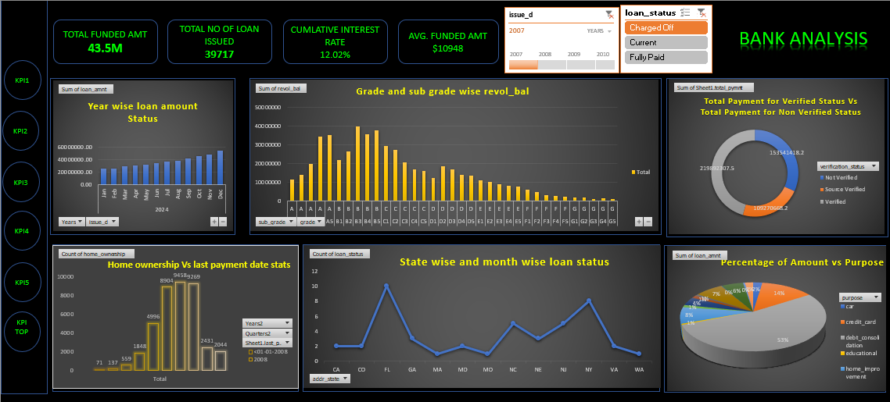

Slide 13
FRAMEWORK FOR SQL
Cleaning of Data as per KPI’S
Created Database in MY SQL
Imported Both Finance_1 & Finance_2 through Import Wizard
Executed using required syntax as per KPI’S

Slide 14
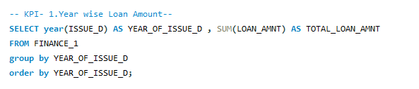
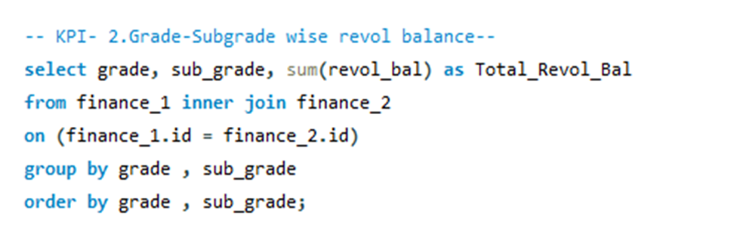
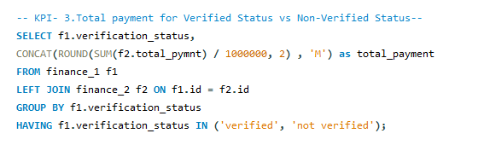
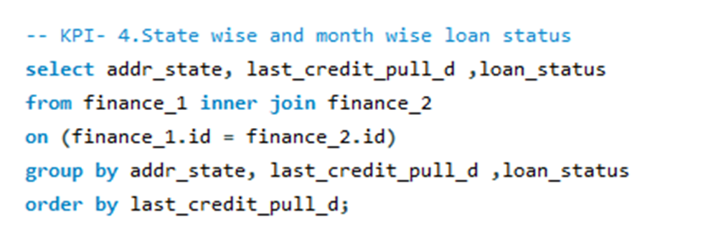
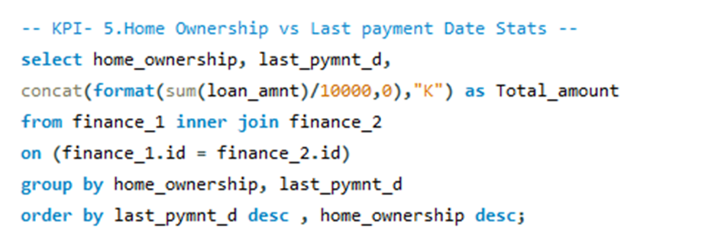

Slide 15
FRAMEWORK FOR POWER BI
Automatic Relationship Created Between Finance_1 And Finance_2.
Cleaned The Data And
Transformed The Data
Created visuals according to the KPI’s
Imported Data In Power BI
Designed All Visuals On Single Sheet For Dashboard

Slide 16
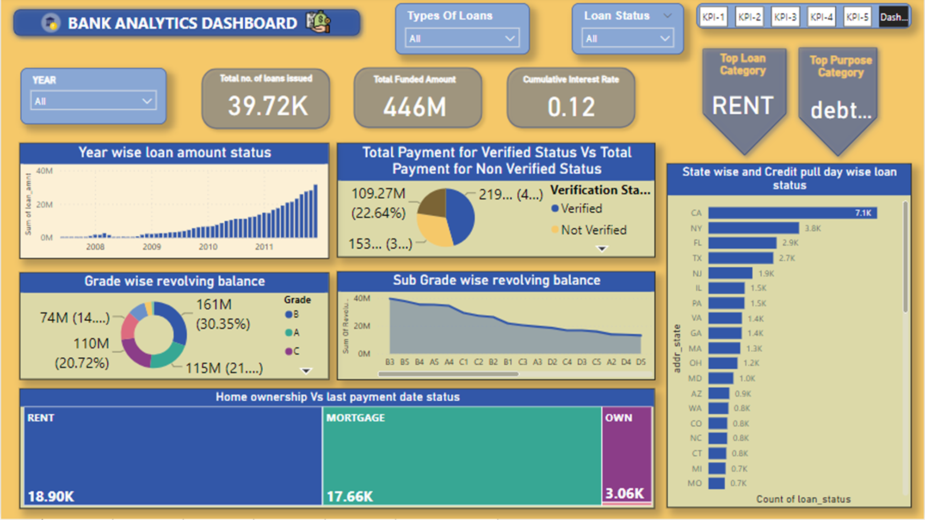

Slide 17
FRAMEWORK FOR TABLEAU
We have to connect finance_1and finance_2 datasets to each other.
Dashboard layout:-
1.Add sheets
2.Arrange Sheets
3.Format the dashboard
Create Union For Both Files
Visualization Layout :–
1.Choose the right chart type
2.configure chart properties
3.Add filters and highlights
Then Clean And Transform Data

Slide 18
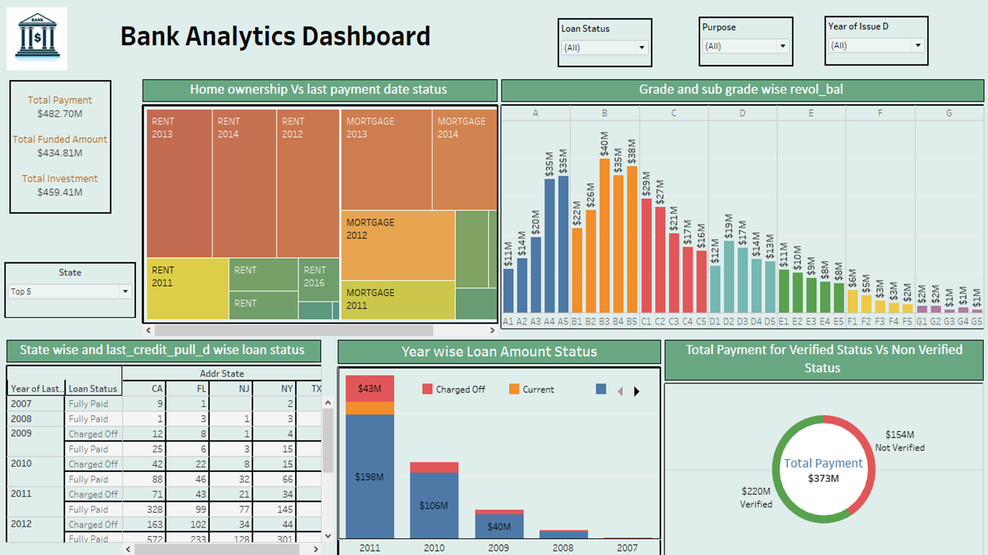

Slide 19
CONCLUSION
Bank loan analytics, utilizing Excel, SQL, Power BI, Tableau, and KPIs in creating dashboards, offers a comprehensive approach to extracting insights and optimizing lending operations. Through Excel, raw data is organized, cleaned, and manipulated, providing a foundational analysis. SQL enables efficient querying and extraction of data from databases, facilitating deeper analysis and insights into customer behavior and loan performance.
Power BI and Tableau offer powerful visualization tools, allowing for the creation of dynamic and interactive dashboards. These dashboards integrate data from multiple sources, providing a holistic view of loan portfolios, customer demographics, credit risk profiles, and loan performance metrics. KPIs, such as loan approval rates, default rates, and customer satisfaction scores, provide actionable insights for decision-making and strategy development

Slide 20
CHALLENGES
Handling a variety of data inputs from different sources, including internal databases and external sources, poses complexity in data management and integration
Ensuring efficient querying and data retrieval from large datasets to provide timely insights requires optimizing query performance and database indexing.
Verifying the accuracy, consistency, and reliability of data inputs is crucial for making informed decisions and avoiding errors in analysis and reporting.
Creating intuitive and visually appealing dashboards that effectively communicate insights to end-users while accommodating diverse user needs and preferences.
Developing and implementing analytics solutions requires acquiring technical skills in data analysis, visualization tools (e.g., Power BI, Tableau), SQL querying, and database management.

Slide 21
Thank you

